Slide 1
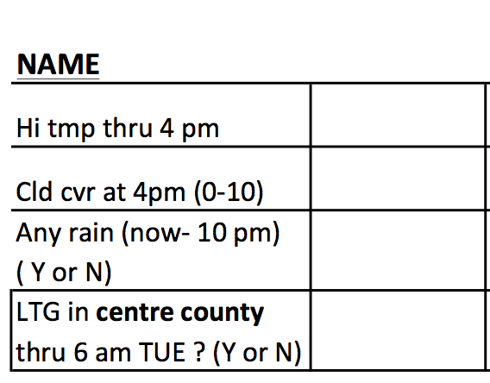
Forecast Verification time!
Senor Perfect Forecast
84
7.5
...
...

Slide 2
Rain began at 11 p.m. … just about 0.10” fell

Slide 3
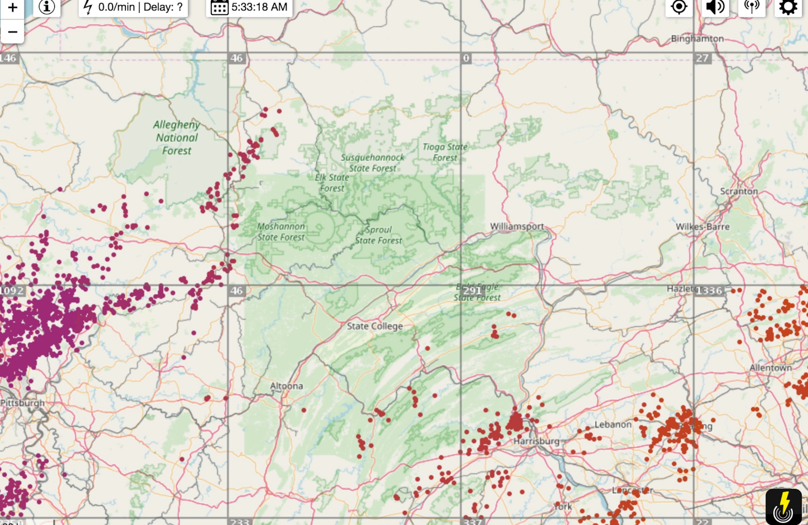

Slide 4
Forecast Verification time!
Senor Perfect Forecast
84
7.5
No ..
No ..

Slide 5
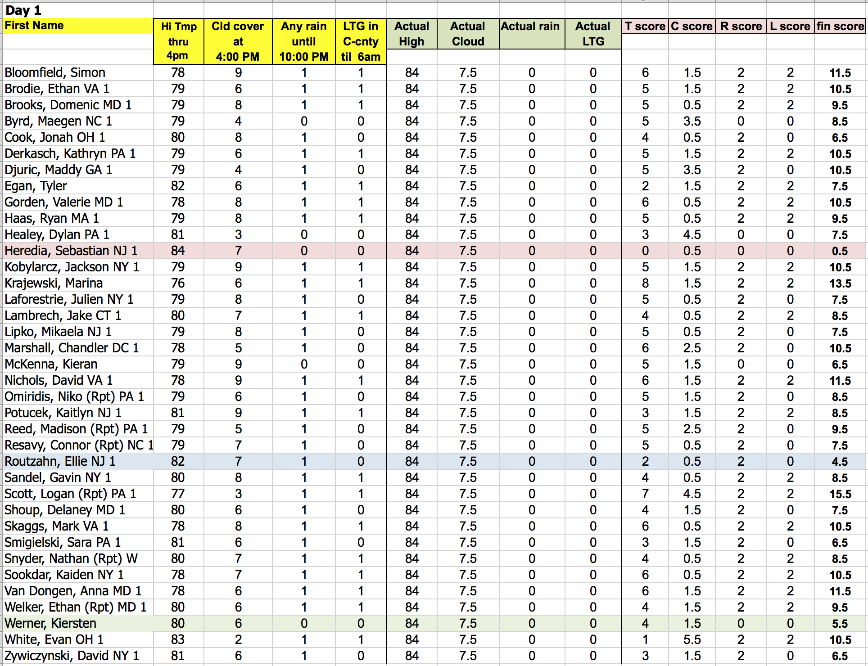
DAY 1
DAY 1

Slide 6
MON 18z = ?
2 p.m.
GFS MODEL
LIFTED INDEX
LIFTED INDEX = measure of how unstable
atmosphere is between sfc and 500mb

Slide 7
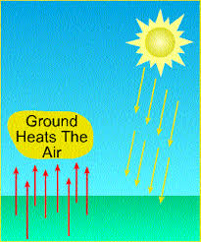
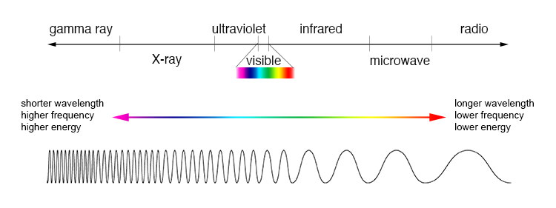
Heating … Heating … Heating (heavy diversion advisory)
Buoyancy =
Tendency for air to
accelerate away from
it’s position
Convection =
Transfer of heat
via air movement
Radiative
heating via
El Sol
Synonym for:
Atmospheric instability
Convective instability
Unstable atmosphere
Convectively unstable
atmosphere
Conduction =
Transfer of heat
via DIRECT contact

Slide 8
Lifted Index (LI)=-5
Convection
Li=?
500mb
-10C
-5C

Slide 9
Lifted Index (LI)=0
Convection
Li=?
500mb
-5C
-5C

Slide 10
Lifted Index (LI)=+5
Convection
Li=?
500mb
-0C
-5C

Slide 11
00z TUE = 8 p.m. MON
06z TUE = 2 a.m. TUE

Slide 12
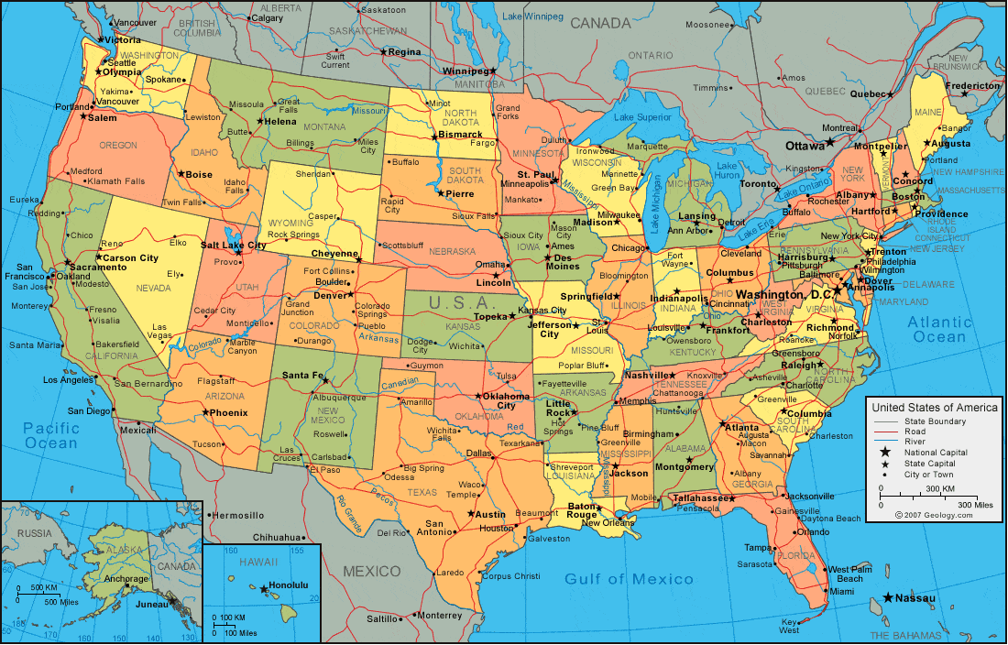
De donde son ustedes?
(Where are you from)
Most interesting weather
at your hometown?

Slide 13
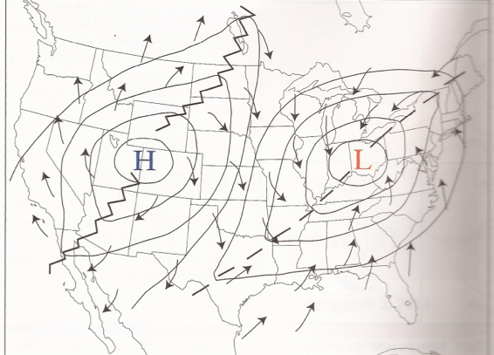
Warm Sector vs. Cool Sector
Air Masses …. Large Volume of air with similar T
and Q characteristics
(Maritime Tropical, Continental Tropical
Maritime Polar, Continental Polar)

Slide 14
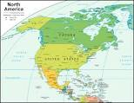
Air Masses ….
Large volume of air with similar T and H characteristics
Maritime Tropical
Continental Tropical
Maritime Polar
Continental Polar
Location Summer Winter
….. Florida ….
90 ... 75 | 75 ... 65
…. Arizona ….
105 … 35 | 70 ... 15
… Coastal AK, BC, Pac NW ..
65 … 55 | 38 ... 35
…. Central Canada …
77 … 48 | 15 … -15

Slide 15
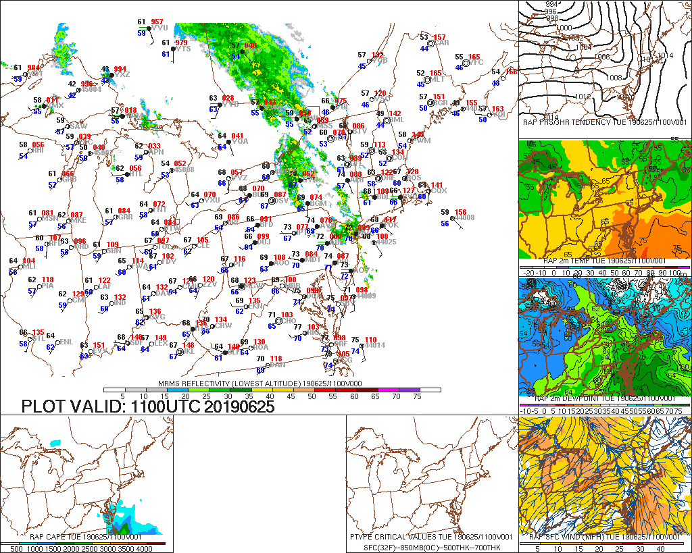
Surface Weather Map (radar overlay)

Slide 16
L

Slide 17
L
500 MB MODEL FORECAST (UPPER LEVELS)
Monday
L
X
H
Wind flow nearly parallel to isobars in upper levels = minimal friction

Slide 18
500 MB MODEL FORECAST (UPPER LEVELS)
Today
L
X
H

Slide 19
700 MB MODEL FORECAST (Mid Levels of troposphere)
This Evening

Slide 20
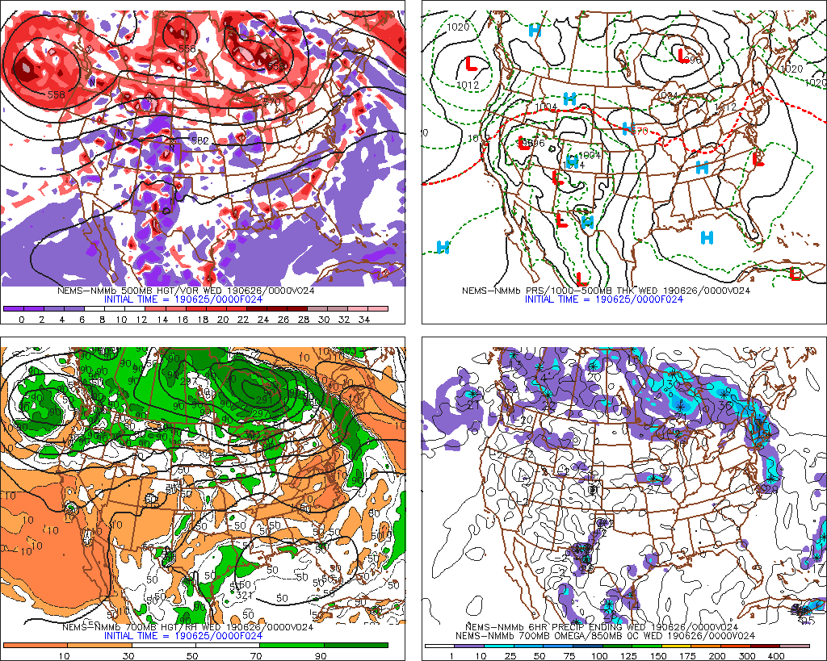
4 panel map – NAM forecast – Valid This evening

Slide 21
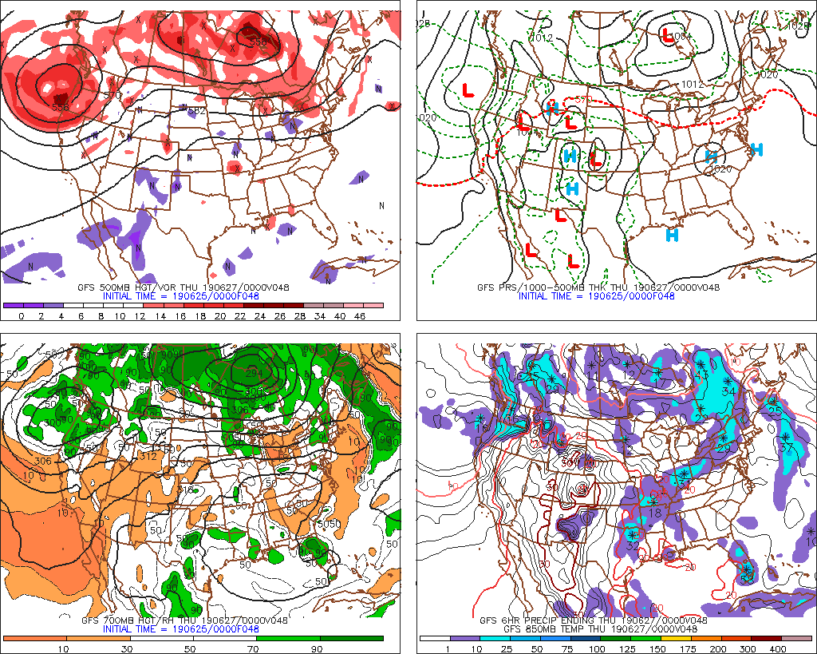
4 panel map – GFS forecast – Valid Tomorrow (WED) evening
500 mb
SFC prs
700 mb
Precip
(12 hrs)

Slide 22
Penn State Weather Camps
Basic Weather Forecasting Guidelines
Sat I – Sat II – Sat III - NWS – NHC - SPC - Radar - Radar - Radar
sfc. map 1 - sfc. map 2 - EWALL - Soundings

Slide 23
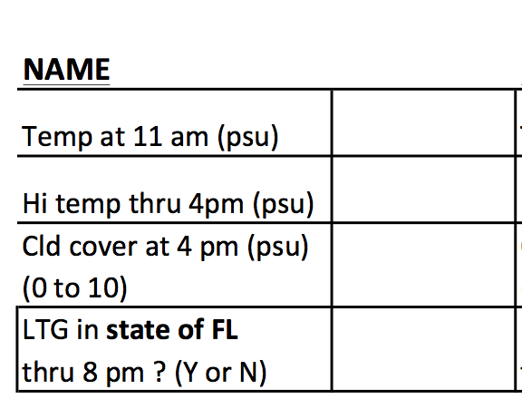
Frank Weather-Climo
~ 73
5
5
YES

Slide 24
CLIMATOLOGY
30 year period - common
NORMAL?
TEMPS
Avg./mean:
81
Conforming to a
regular pattern;
typical
Median:
Range:
82
90 - 68
Std. dev.
7
60’s =
70’s =
80’s =
90’s =
2
8
18
2
RAIN
Avg./Mean:
Range:
% time:
0.15”
0-1.79”
43%

Slide 25
WHAT IS CLIMATOLOGY ?
How the weather behaves over
a long period of time.
Weather – Behavior of the atmospheric over a much shorter
period of time

Slide 26
Climatology Forecast
Key West Boston
CLI 88 77
6/16 88 72
6/17 86 75
6/18 86 70
6/19 88 71
6/20 88 73
6/21 89 76
6/22 89 83
6/23 88 87
AVG ERR.
0.75 5.1
BIAS
0.25 1.1

Slide 27
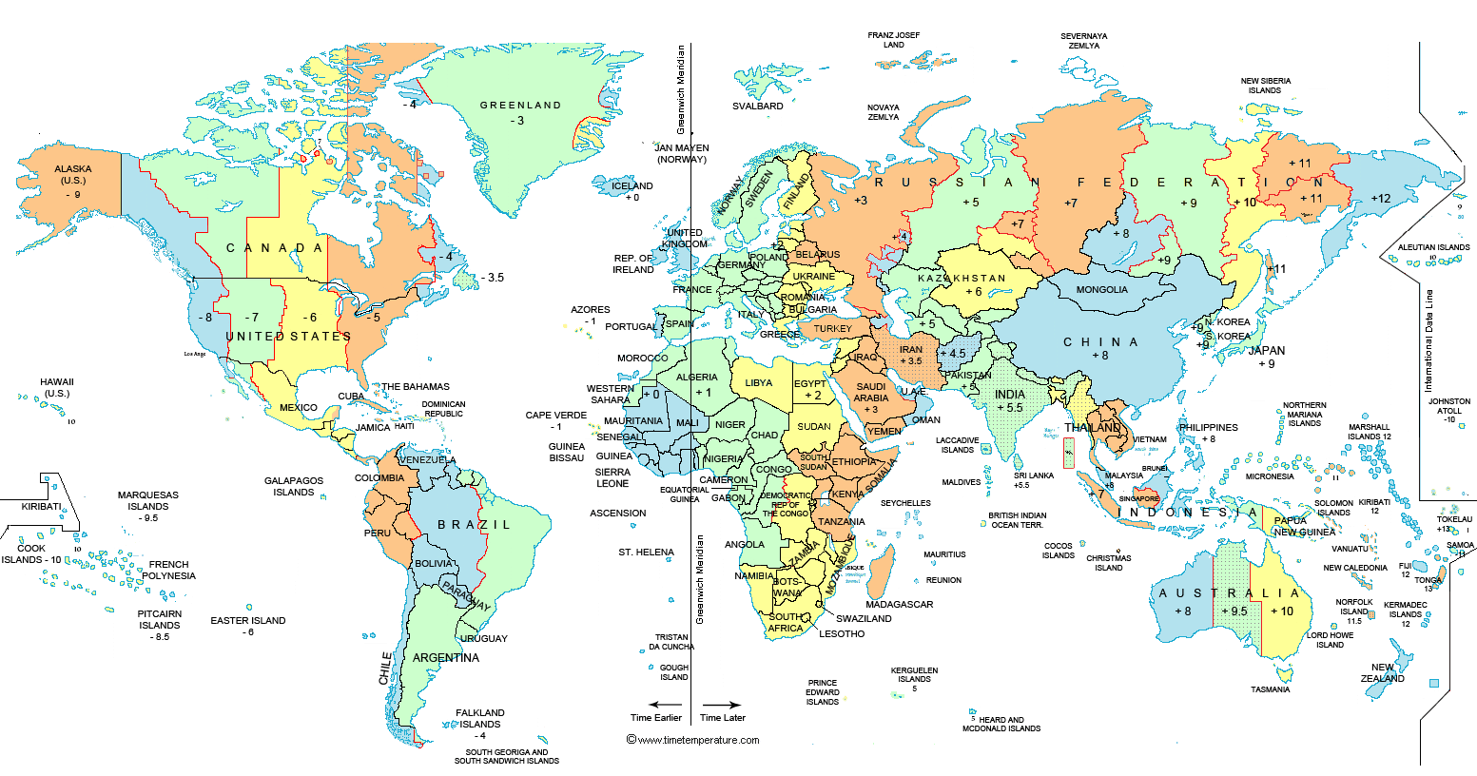
If it’s 10 UTC / 10 zulu / 10 Z time …..
-4
DST

Slide 28
YYZ = Station
63 =
54 =
105 =
Surface Observations
Temp
Dewpoint
SL Pressure
Sky cover
Station =
Temp =
Dewpoint =
Pressure =
PIT
65
58
1011.2mb
SE 5 kts

Slide 29
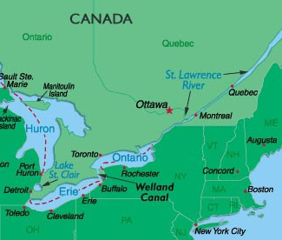
=Lt. Rain

Slide 30
Surface Weather Map +
Other nifty analyses ☺

Slide 31
L

Slide 32
L
H
H

Slide 33
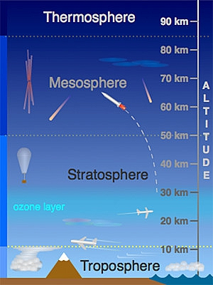
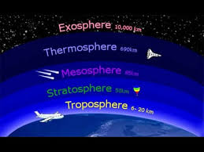
500mb

Slide 34
...Ohio Valley/Southern and Central Appalachians...
An upper-level trough will move eastward across the Mississippi
Valley today as southwest mid-level flow remains over east-central
U.S. At the surface, a cold front will advance eastward into the
Ohio and Tennessee Valleys as a corridor of maximized low-level
moisture sets up ahead of the front.
Surface dewpoints in the upper
60s F should result in moderate instability by midday across much of
the moist sector. As surface temperatures warm and low-level
convergence increases along the front, scattered convection is
forecast to initiate along and ahead of the front.

Slide 35
...Ohio Valley/Southern and Central Appalachians...
Linear MCS development will be possible as storms increase in coverage
and move northeast across the moist sector during the afternoon. RAP
forecast soundings ahead of the front by 21Z from northern Kentucky
southward into the southern Appalachian Mountains show MLCAPE values
from 1000 to 2000 J/kg with steep low-level lapse rates.
This along about 30 kt of 0-6 km shear should be favorable for isolated
damaging wind gusts. Hail will also be possible with the stronger
cells embedded in the any line that becomes established.

Slide 36
Frank Weather-Climo
81
5
NO
NO

Slide 37
Penn State Weather Camps
Basic Weather Forecasting Guidelines
Sat I – Sat II – Sat III - NWS – NHC - SPC - Radar - Radar - Radar
sfc. map 1 - sfc. map 2 - EWALL

Slide 38
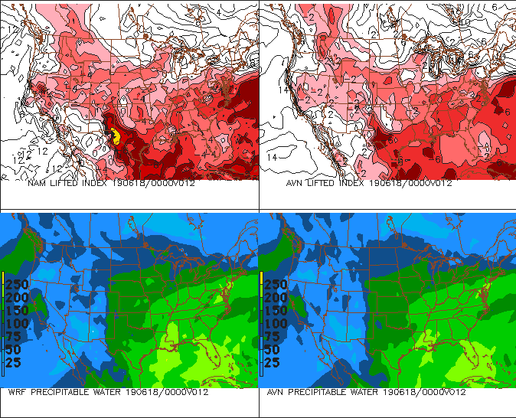
NAM MODEL
MON EVE
GFS MODEL
LI =
LIFTED INDEX
LIFTED INDEX = measure of how unstable
The atmosphere is between sfc and 500mb
Precipitable Water = If we “wrung” out all the moisture
in the atmosphere, how much precip would we get

Slide 39
Buoyancy =
Tendency for air to
Accelerate
Convection
Conduction

Slide 40
Lifted Index (LI)=-5
Convection
Li=?
500mb
-10C
-5C

Slide 41
Lifted Index (LI)=0
Convection
Li=?
500mb
-5C
-5C

Slide 42
Lifted Index (LI)=+5
Convection
Li=?
500mb
-0C
-5C

Slide 43
Warm Sector vs. Cool Sector

Slide 48
WHAT IS PERSISTENCE ?
ASSUMES NO CHANGE !
WHAT HAPPENED …
WILL CONTINUE TO HAPPEN

