Slide 1
Office of the Associate Dean for Educational Equity
www.ems.psu.edu/ems-educational-equity
Dr. Victoria E. Sanchez Associate Dean for Educational Equity

Slide 2
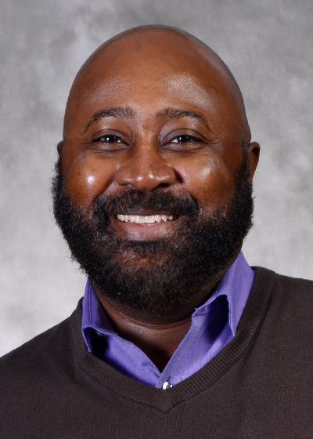
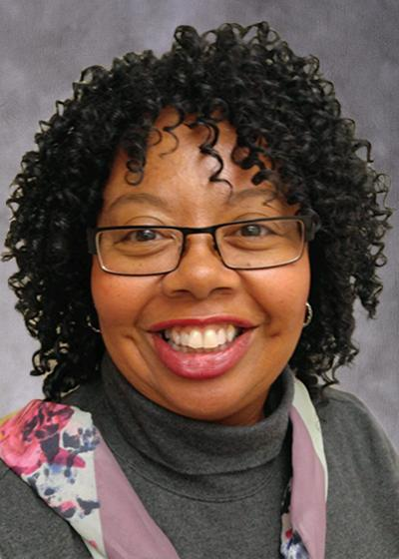
EMS Educational Equity
James Guyton
Email:
jrg6@psu.edu
Phone:
814-867-2455
Office Address:
104 Deike Building
Title:
Coordinator of Multicultural Affairs
Lori Robinson
Email:
lrr5@psu.edu
Phone:
814-867-2455
Office Address:
104 Deike Building
Title:
Administrative Support Coordinator
EMS Educational Equity
www.ems.psu.edu/ems-educational-equity

Slide 3
College of Earth and Mineral Sciences
5 Departments:
John and Willie Leone Family Department of Energy and Mineral Engineering
Department of Geography
Department of Geosciences
Department of Materials Science and Engineering
Department of Meteorology and Atmospheric Science
16 majors, 2 available online, 17 minors
Visit https://www.ems.psu.edu/ and click on “Undergraduate” to explore what the College has to offer

Slide 4
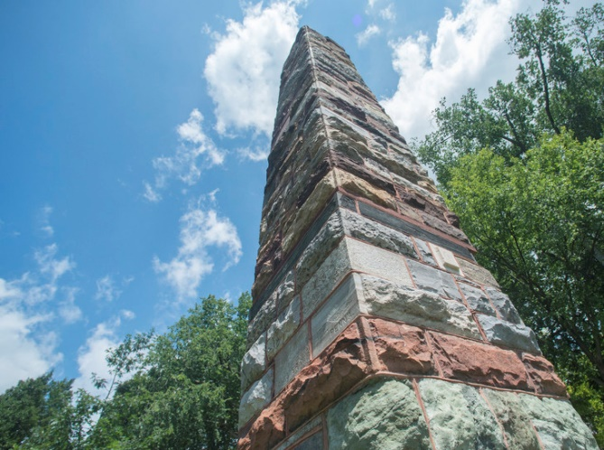
EMS – A small college in a large university
Building Community and Supporting Students
Ryan Family Student Center,
Office of Student Engagement
first year orientation,
undergrad research opportunities
EMS Student Council, Student organizations – professional and social, Minorities in EMS (MEMS), Women in EMS (WEMS), Out in STEM (oSTEM) … and more
EMEX student run open house, CUE –student research exhibition
Office of Educational Equity (Diversity, Equity, and Inclusion)

Slide 5
Applying to Penn State
Additional Programs to Consider
Schreyer Honors College https://www.shc.psu.edu/ Penn State’s Honors program
Millennium Scholars Program https://www.millennium.psu.edu Brings in scholars dedicated to continuing to PhD studies and to increasing diversity in STEM
McNair https://gradschool.psu.edu/diversity/mcnair Prepares underrepresented and first generation college students for graduate school success
Penn State admissions
http://psu.edu click the yellow button at the top that says “apply now”
Lots of information and tools such as cost calculators etc
Lots of visit programs such as spend a summer day, spend a fall day and more

Slide 6
Questions for You:
Why is diversity, equity, and inclusion important in education and in STEM?
What has to happen to achieve it?

Slide 7
Diversity, Equity, Inclusion, and Belonging
EMS is committed to diversity, equity, inclusion and belonging and expects that everyone be actively engaged with fostering an equitable, inclusive environment where each member feels a sense of belonging and can thrive. Our areas of focus include:
ALLWE - our comprehensive inclusion and equity initiative
LGBT
women in STEM
first generation-low income students
anti-racism

Slide 8
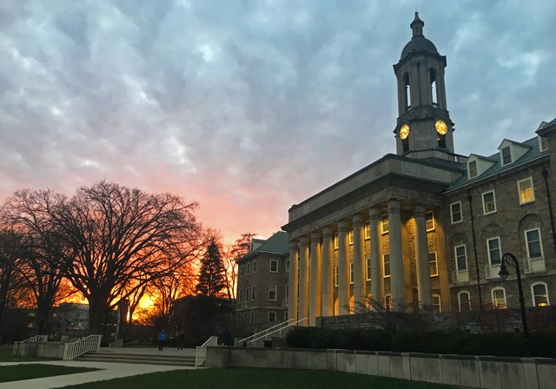
Tips for Preparing for College
APPLY EARLY for the best consideration for scholarships and programs
Start preparing now
Do well in your math classes
Learn to manage your time and your money
Learn more about your concerns about college life

Slide 9
Questions for Me?

