Slide 1
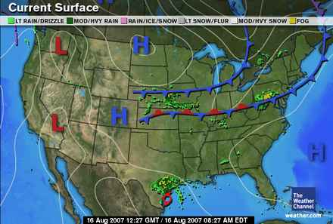
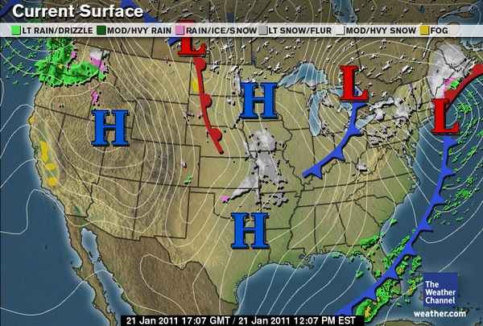
The Surface Weather Map
“Surface” of the earth
Symbols
What do they mean?
What kind of weather might one expect in their vicinity?
How was the location of the weather features determined?
What are those lines on the map?

Slide 2
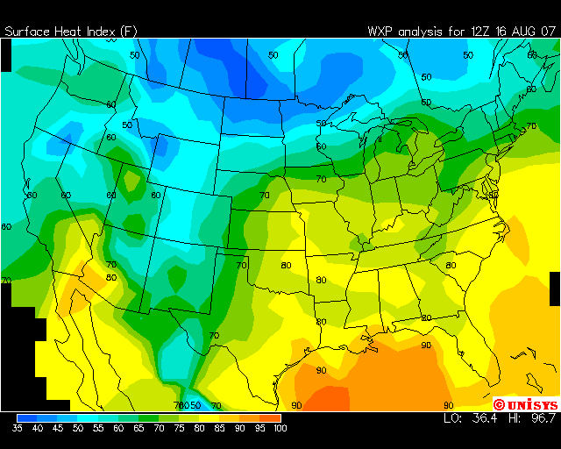
The Surface Weather Map
Again, this map is for the surface level, but there are weather maps for many other levels /elevations above the ground too
Contour Plot
Lines of constant values, color coded
Heat Index in this case, but can be temperature, pressure, wind speed, anything!

Slide 3
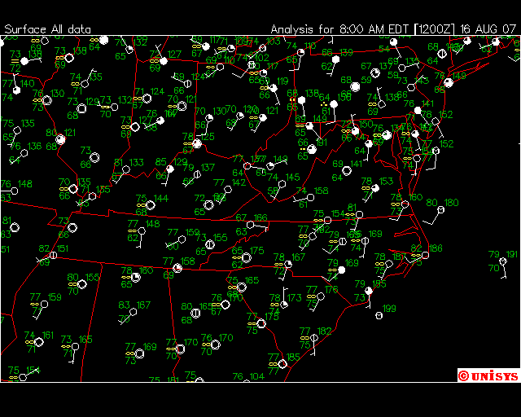
The Surface Weather Map
Surface data comes from thousands of weather monitoring stations across the country, and the rest of the world- this is a map showing only a few of those available in the Mid-Atlantic and Ohio Valley
Efficient way of plotting lots of important data in a small space

Slide 4
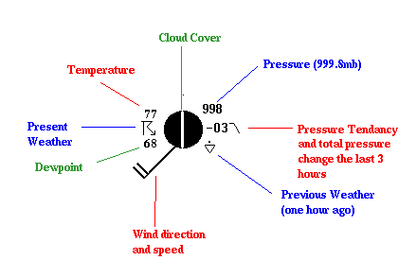
The Surface Weather Map- Weather Station Model
See page 27 of your text for more explanation
Efficient way of plotting lots of important data in a small space

Slide 5
Isopleths (Contours)
Most common weather maps will contain some type of isopleth
Common examples include
Isotherm: temperature
Isobar: pressure
Isotach: wind speed
Isodrosotherm: dew point

Slide 6
Rules of the Isoplething Road

Slide 7
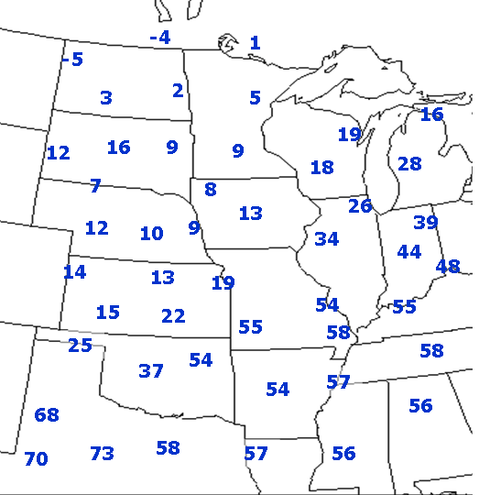
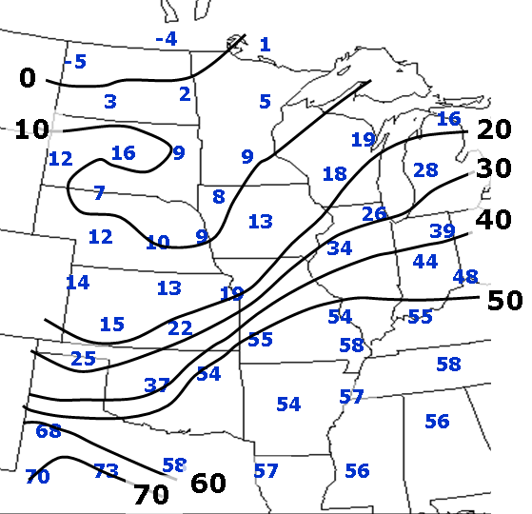
Isoplething Example
Contouring to visualize spatial data.

Slide 8
Isoplething Example

Slide 9
What’s Wrong with this Picture?

Slide 10
Let’s Try One…

Slide 11
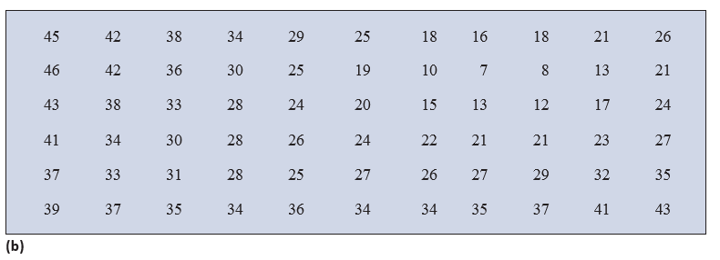
Let’s Try One More…

