Slide 1
The Tropical Cyclone
A low pressure system
Tropical origin, naturally!
Organized mass of
thunderstorms
Tropical cyclones with
sustained winds ≥ 74 mph
have different names:
Hurricane (North Atlantic and eastern North Pacific)
Typhoon (western North Pacific)
Cyclone (Indian Ocean and southern hemisphere)

Slide 2
Hurricane Charley, Punta Gorda, FL, 2004

Slide 3
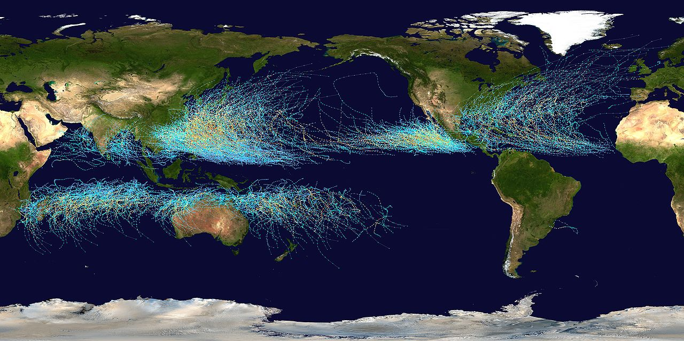
Historical Tropical Cyclone Tracks
Land
Cold
Land
Equator Equator Equator Equator Equator Equator Equator Equator Equator Equator
Cold
Cold
Cold Cold Cold Cold Cold Cold Cold Cold Cold Cold Cold Cold Cold Cold Cold Cold

Slide 4
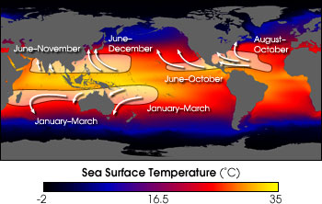
The Hurricane: Birth Regions
Not over land
Not high latitudes
But, not at the equator (Graphic by Robert Simmon, NASA GSFC)

Slide 5
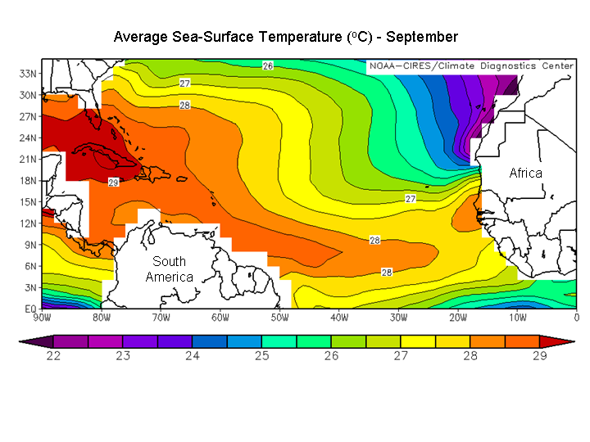
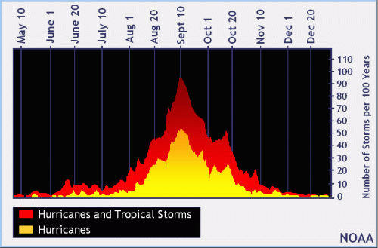
The Hurricane: Frequency, Season
Atlantic season runs from June through November
Peak frequency around September 10th
Water at its warmest
Largest surface area of warm water

Slide 6
Stages of Development I
Tropical disturbance: disorganized blob of thunderstorms, often forms within the ITCZ
If atmosphere and ocean conditions favor development, we enter a positive feedback loop
Massive heat release via condensation – warm core
Increased pressure aloft
Upper-level divergence
Lower surface pressure
Increased inflow, fuel for more thunderstorms…
Tropical depression: organized thunderstorms, circular wind flow around center, sustained wind speed < 39 mph

Slide 7
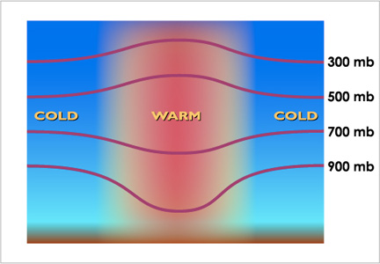
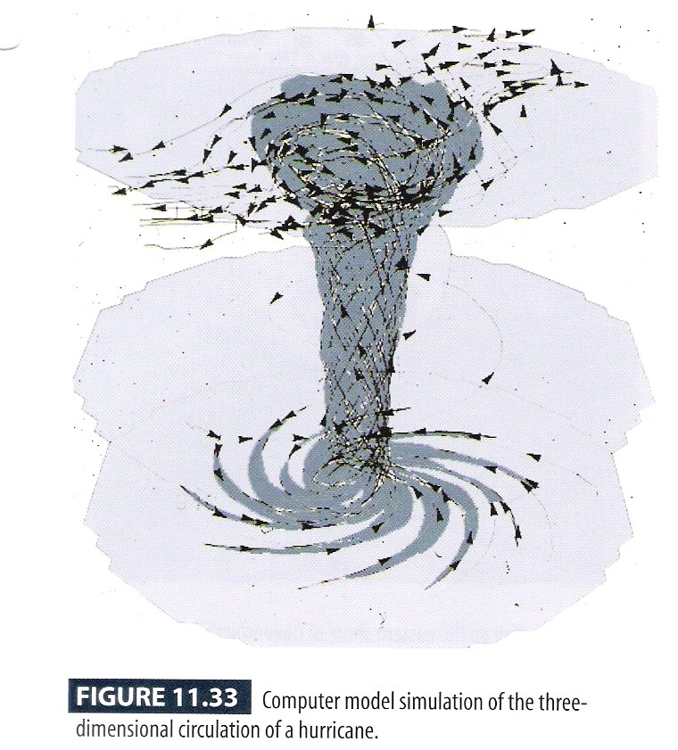
Warm Core Structure
H
L
(Adapted from Moran & Morgan, 1997)

Slide 8
Stages of Development II
Tropical Storm: sustained wind speeds from 39-73 mph with stronger gusts
Storm gets a name
Six-year cycle (link to NHC)
Names reused or retired
If conditions remain favorable, positive feedback loop continues, leading to…

Slide 9
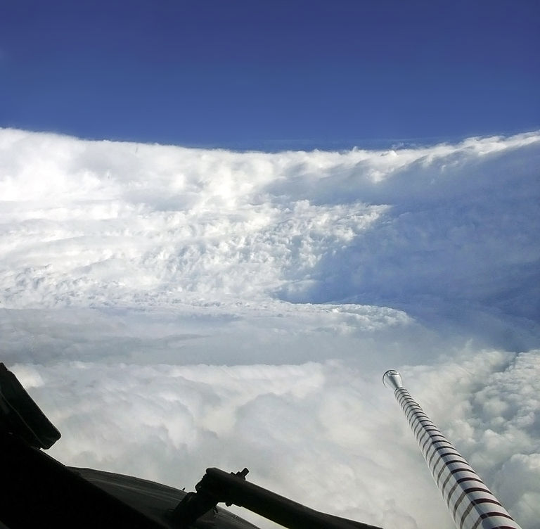
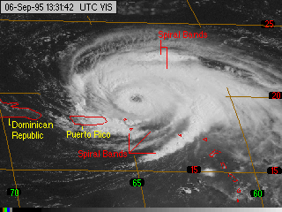
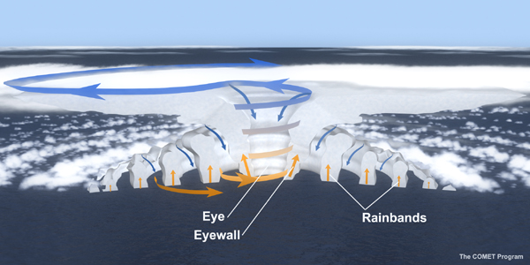
Stages of Development: Hurricane
Sustained wind speed ≥ 74 mph
An eye usually forms
Storm has a warm core
Varying width, “Stadium Effect”
Spiral bands
Conservation of angular momentum

Slide 10
Hurricane: Saffir-Simpson Wind Scale
Category | Winds | Damage
1 | 74-95 mph | Some
2 | 96-110 mph | Extensive
3 | 111-129 mph | Devastating
4 | 130-156 mph | Catastrophic
5 | ≥ 157 mph | Catastrophic
Pitfall 1: Strongest winds felt by few
Pitfall 2: Neglects storm surge

Slide 11
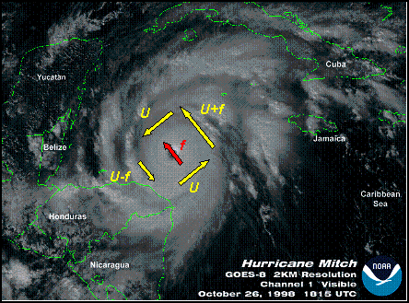
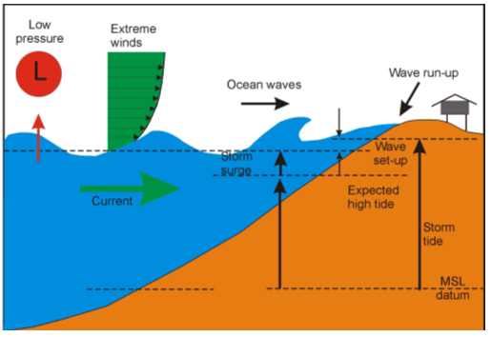
Storm Surge
Water, not wind, is by far the biggest killer!! (includes both storm surge and fresh water flooding)
Right front quadrant is most dangerous (Northern Hemisphere)
Strongest winds (rotation + translation velocities)
Winds blow on-shore which piles up water

Slide 12
Storm Surge, the Big Killer

Slide 13
Surge in Philippines (Typhoon Haiyan)

Slide 14
Demise
Loss of fuel (water vapor)
Moves across colder water
Moves over land
Strong wind shear (vertical change of horizontal wind)
Tilts the thunderstorms
Lowest pressure not concentrated, pressure gradient relaxes and winds weaken
Increased friction (landfall)

Slide 15
Key Figures
11.5, 11.9, 11.37, 11.41, 11.51, 11.52

